Slide 1

Friends of the Episcopal Church in Cuba
Webinar
October 18th, 2026

Slide 2
Today’s Webinar
Introduction/Welcome Pat Cage
Current State of Affairs in Cuba Rev. Mark Pendleton
Video Message from Rev. Halbert Pons
Update from Bishop Angel Rev. Mark Pendleton
Project Feliz Navidad 2026 Pat Cage
Closing Rev. Mark Pendleton

Slide 3
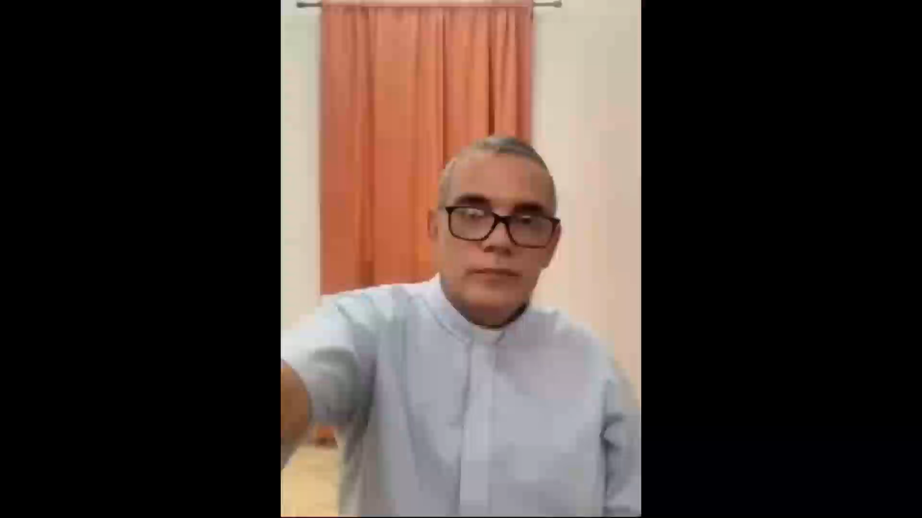
Message from Rev. Halbert Pons, Dean of the Cathedral in Havana

Slide 4
Continuation of Rev. Halbert’s remarks
Every day you go to bed unsure of what you are going to eat tomorrow. Besides you can only buy food in private markets, where the prices are much higher than the average salary, which is barely enough for a single bottle of oil.
Health is another great challenge of today, hospitals do not have any medicine,people with treatable illnesses are dying because they can't receive any treatment, and the ones who have cancer are worse.
I have seen doctors crying because they can't save their patients because of the lack of medicine. If you get a serious illness, you have to buy absolutely everything for the treatment . Hospitals don't have anything to spare, the only thing they have is capable doctors, but those doctors doesn't have anything to work with. Literally, every person that heals is a miracle of love and sacrifice of friends and family.
The trash and filth keeps growing every day, piling up in the corners of the streets; and most of the time there´s no water.
The country is becoming less and less safe, the violence and vandalism are higher, caused by poverty; and the use of drugs is more and more common among the young. It is terrible to live with fear of not knowing if someone is going to break into your house, or if someone is going to rob you on your way home.

Slide 5
Continuation of Rev. Halbert’s remarks
We are a nation that has mortgaged their future. Most of the young have left or want to leave the country. And the ones who are still here are not getting a good education. Imagine that most of schools only work two or three times a week only for a few months. The rest of the time they make up with online classes (but we all know well how the internet works here). Education today is in a critical state, and it focuses more on indoctrination than on formation.
I wish I had better news about our reality, but it isn't the case. Months ago, we had a lot of hope for a deep change. This hope has died as time passed and nothing changed. Things only get worse, and I believe that as people and as a country we are at the limit of how much we can endure.
Today, in this highly adverse political, economic, and social situation, the church is trying to keep the best of this society so in the future we can rebuild our nation. I believe that we Christians are the light that has been called to shine upon this darkness.
And together with us are all of you, your unconditional love, your constant prayers and your generous help that make this calvary more bearable. Thanks to all of those friends that keep worrying about us.
We can say that God hasn't abandoned us, even when many times we cried to heaven with the psalmist in psalm 13: "How long, LORD!?"
We keep walking and trusting in the promise of a God that will not abandon us. We too say with the psalmist: "But I trust in your unfailing love; my heart rejoices in your salvation".
With a hug and my blessing.

Slide 6
Bishop Angel’s Recent Update
I wish to express my eternal gratitude to the Friends of the Episcopal Church of Cuba for their unconditional support at the time we need it most.
2025 operating budget funds finally received in Havana last Monday, so outstanding pay for Clergy, pastoral leaders and administrative staff should be complete this week.
1st half 2026 operating budget funds expected to arrive in Havana within the next few weeks.
Hunger remains a critical issue along with severe energy and water shortages.
The diocese has plans to expand to new geographic areas across Cuba and to establish new missions. Our aspiration is to win lives for Christ and to see the Church grow at a time when attendance in our congregations is rising; we want to reach areas where we do not yet have a presence.
Through a collaboration involving the Grain Food Bank of Canada, CARE International, Alongside Hope Canada, and our Diocese, we are now in the second month of a project providing food assistance to 3,000 families across the region from Las Tunas to Guantánamo.

Slide 7
Bishop Angel’s Recent Update (Cont)
We have opened a preschool education center at San Juan Evangelista in Bacuranao, joining the existing centers at San Lucas and Santa María in Santiago de Cuba.
Seventeen people will begin studies at the Center for Theological Education; most are already serving as lay pastoral leaders in various missions under the supervision of our priests.
We issued a statement denouncing the living conditions, health issues, hunger, and intimidation faced by the Cuban people—factors driving thousands of young people and adults to migrate en masse from the island due to a lack of opportunities and the repression to which they are exposed.
What we need most are your prayers and visits. We are aware of the news reaching the United States, but we invite you to organize trips to the island. We have worked to lower the cost of religious visas so that more of you can visit us. We also wish to install a solar panel system to ensure the guesthouse operates properly so we can welcome you.

Slide 8

Project Feliz Navidad 2026 – Our 5th Year
For the past 5 years, we have supported Episcopalians throughout Cuba by providing all 52 churches with a Christmas meal for their congregations/communities.
As Bishop Angel has declared - "These Christmas meals change lives and bring hope. They say we are not forgotten. And Cuba needs hope now more than ever".
Last year's campaign to provide a Christmas dinner celebration for all 52 Episcopal communities across Cuba was a huge success.
Our goal for this year is $400 per community (a total of $21,000).
Please give generously, and send checks made payable to FECC
(with Feliz Navidad in the memo line) to:
Rev. Mark Pendleton - Treasurer, 218 Post Road, Greenland, NH 03840
All donations are tax deductible as we are a 501C3 organization.

Slide 9
Thank You
www.friendsofeccuba.org

